Slide 1
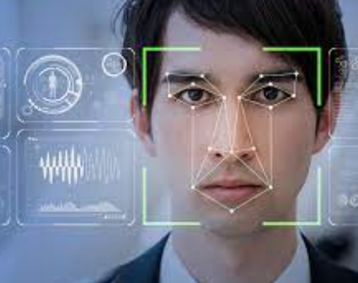
Face Detection Using Machine Learning

Slide 2



Meet our team Group 10:
Venkata Sumanth
Nagabhairu
Sudheera Ambavaram
CWID : 20012395
CWID: 20011886
Yogesh Gutta
CWID: 20010910

Slide 3

Agenda
1.Introduction
2.Innovation of project
3.Scope of the project
4.OpenCV python
5.Face detection classifiers
6. Code
7 Conclusion

Slide 4
1.Introduction
Face detection is an AI-based computer technology that can identify and locate the presence of human faces in digital photos and videos. It can be regarded as a special case of object-class detection, where the task is to find the locations and specify the sizes of all the objects that belong to a given class – in this case, faces – within a specific image or images.
Due to the advancements in face detection technology, it is now possible to detect faces in an image or video, regardless of head pose, lighting conditions, and skin color.

Slide 5
2..Innovation of project
1.It can Detect faces easily with less time of execution.
2. It can Detect Face in any quality of Images even blur.
3. It can Detect single, double or even multiple faces in any Image.
4. It use Haar feature based Algorithm to detect which it makes very accurate and fast processing of face detection

Slide 6
3.Scope of the project
Unlocking Phones and Offices
Social Media
Home Security
Photography

Slide 7
4.OpenCV python
OpenCV essentially stands for Open Source Computer Vision Library. Although it is written in optimized C/C++, it has interfaces for Python and Java along with C++. OpenCV boasts of an active user base all over the world with its use increasing day by day due to the surge in computer vision applications.
OpenCV-Python is the python API for OpenCV. You can think of it as a python wrapper around the C++ implementation of OpenCV. OpenCV-Python is not only fast (since the background consists of code written in C/C++) but is also easy to code and deploy(due to the Python wrapper in foreground). This makes it a great choice to perform computationally intensive programs.

Slide 8
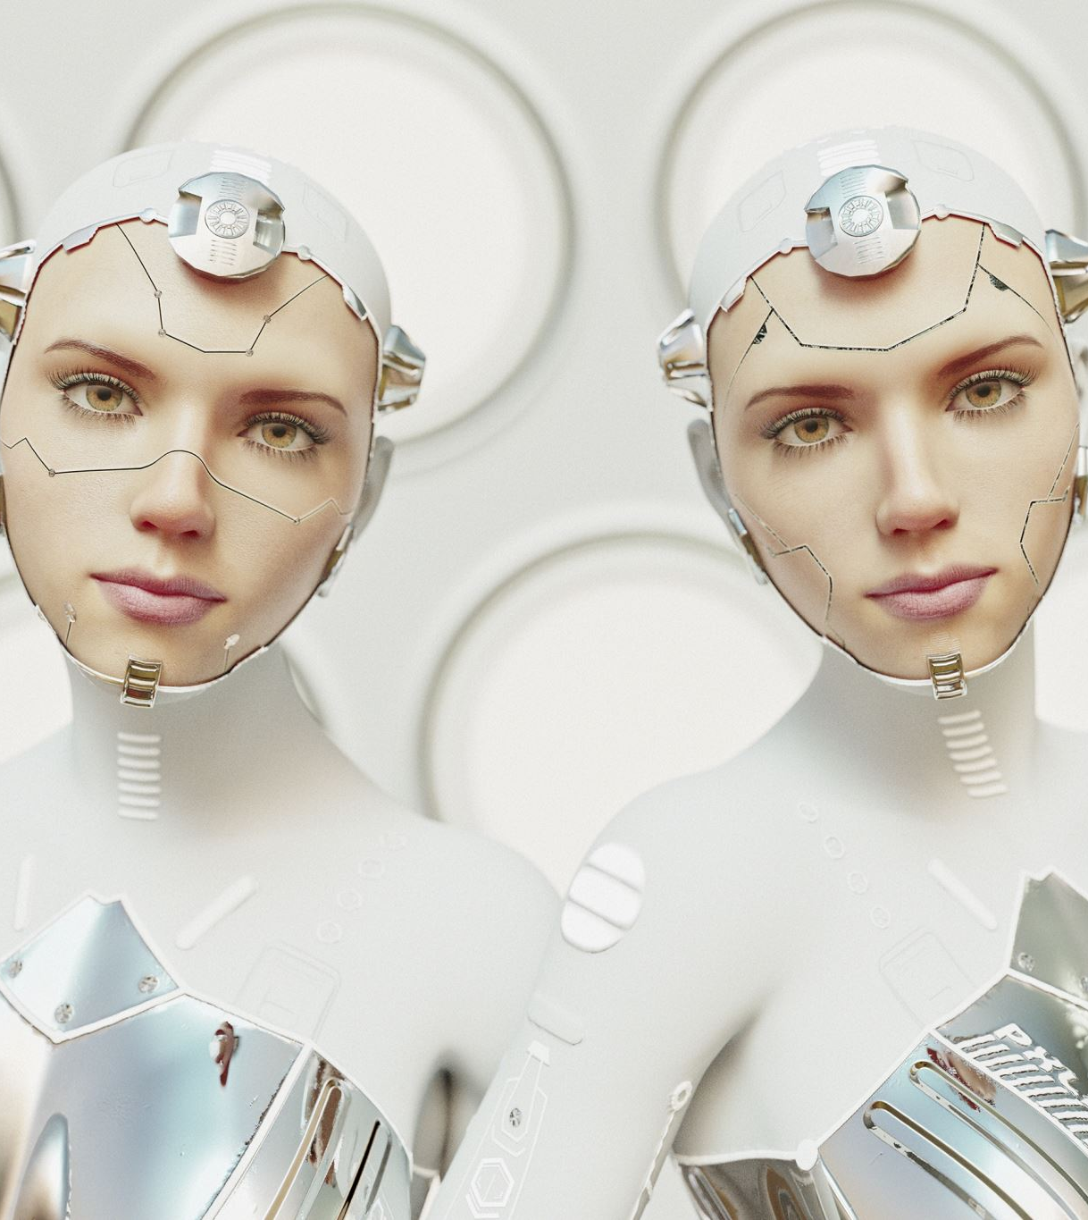
5.Face detection classifiers
Face detection is performed by using classifiers. A classifier is essentially an algorithm that decides whether a given image is positive(face) or negative(not a face). A classifier needs to be trained on thousands of images with and without faces. Fortunately, OpenCV already has two pre-trained face detection classifiers, which can readily be used in a program. The two classifiers are:
Haar Classifier
Local Binary Pattern (LBP)
For this Project, Will only discuss the Haar Classifier for Face Detection as it best method for detection.

Slide 9

6. code^
import cv2
import sys
import logging as log
import datetime as dt
from time import sleep
cascPath = "haarcascade_frontalface_default.xml"
faceCascade = cv2.CascadeClassifier(cascPath)
log.basicConfig(filename='webcam.log',level=log.INFO)
video_capture = cv2.VideoCapture(0)
anterior = 0

Slide 10
6. code^
while True:
if not video_capture.isOpened():
print('Unable to load camera.')
sleep(5)
pass
# Capture frame-by-frame
ret, frame = video_capture.read()
gray = cv2.cvtColor(frame, cv2.COLOR_BGR2GRAY)
faces = faceCascade.detectMultiScale(
gray,
scaleFactor=1.1,
minNeighbors=5,
minSize=(30, 30)
)

Slide 11
6. code^
# Draw a rectangle around the faces
for (x, y, w, h) in faces:
cv2.rectangle(frame, (x, y), (x+w, y+h), (0, 255, 0), 2)
if anterior != len(faces):
anterior = len(faces)
log.info("faces: "+str(len(faces))+" at "+str(dt.datetime.now()))
# Display the resulting frame
cv2.imshow('Video', frame)
if cv2.waitKey(1) & 0xFF == ord('q'):
break
# Display the resulting frame
cv2.imshow('Video', frame)
# When everything is done, release the capture
video_capture.release()
cv2.destroyAllWindows()

Slide 12

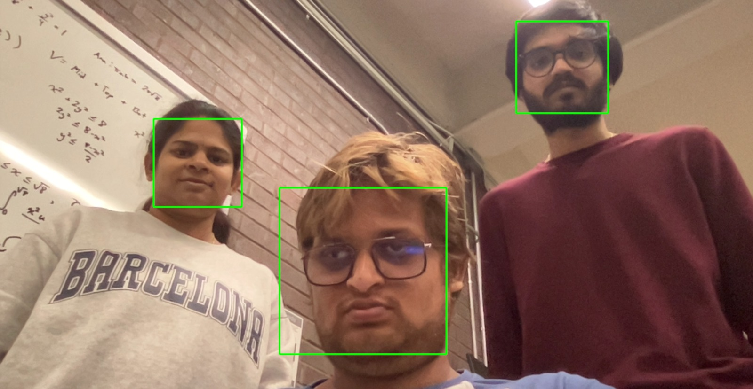
Result

Slide 13

7. Conclusion
Successfully detected the human faces using a webcam.

Slide 14
Thank you

